Slide 1
HUMAN TRAFFICKING:
Creating Awareness to Prevent and Intervene

Slide 2
LAND ACKNOWLEDGEMENT
I would like to acknowledge the land on which we are living is the traditional unceded and unsurrendered territory of the Wəlastəkwiyik (Maliseet). This territory is covered by the “Treaties of Peace and Friendship” which Wəlastəkwiyik (Maliseet), Mi’kmaq and Passamaquoddy Peoples first signed with the British Crown in 1726. The treaties did not deal with surrender of lands and resources but in fact recognized Mi’kmaq and Wəlastəkwiyik (Maliseet) title and established the rules for what was to be an ongoing relationship between nations.
The colonial legacy continues today as statistics show that 50% of trafficked girls and 51% of trafficked women identify as Indigenous.

Slide 3
Today's Objectives
1
Introduction to human trafficking
2
Different types of trafficking
3
Hotels and human trafficking
4
Commitment to act

Slide 4
Marianna's Experience
At the age of 16, trafficked at hotels and motels in Halifax, Toronto and Moncton before being hospitalized for malnutrition.
"He was very manipulative and almost condescending in the way that he made it seem like he knew more that I did about my own life and what I could do in my life. And kind of promising me that he could change my life and that I could make lots of money and have the life that I always wanted.”

Slide 5
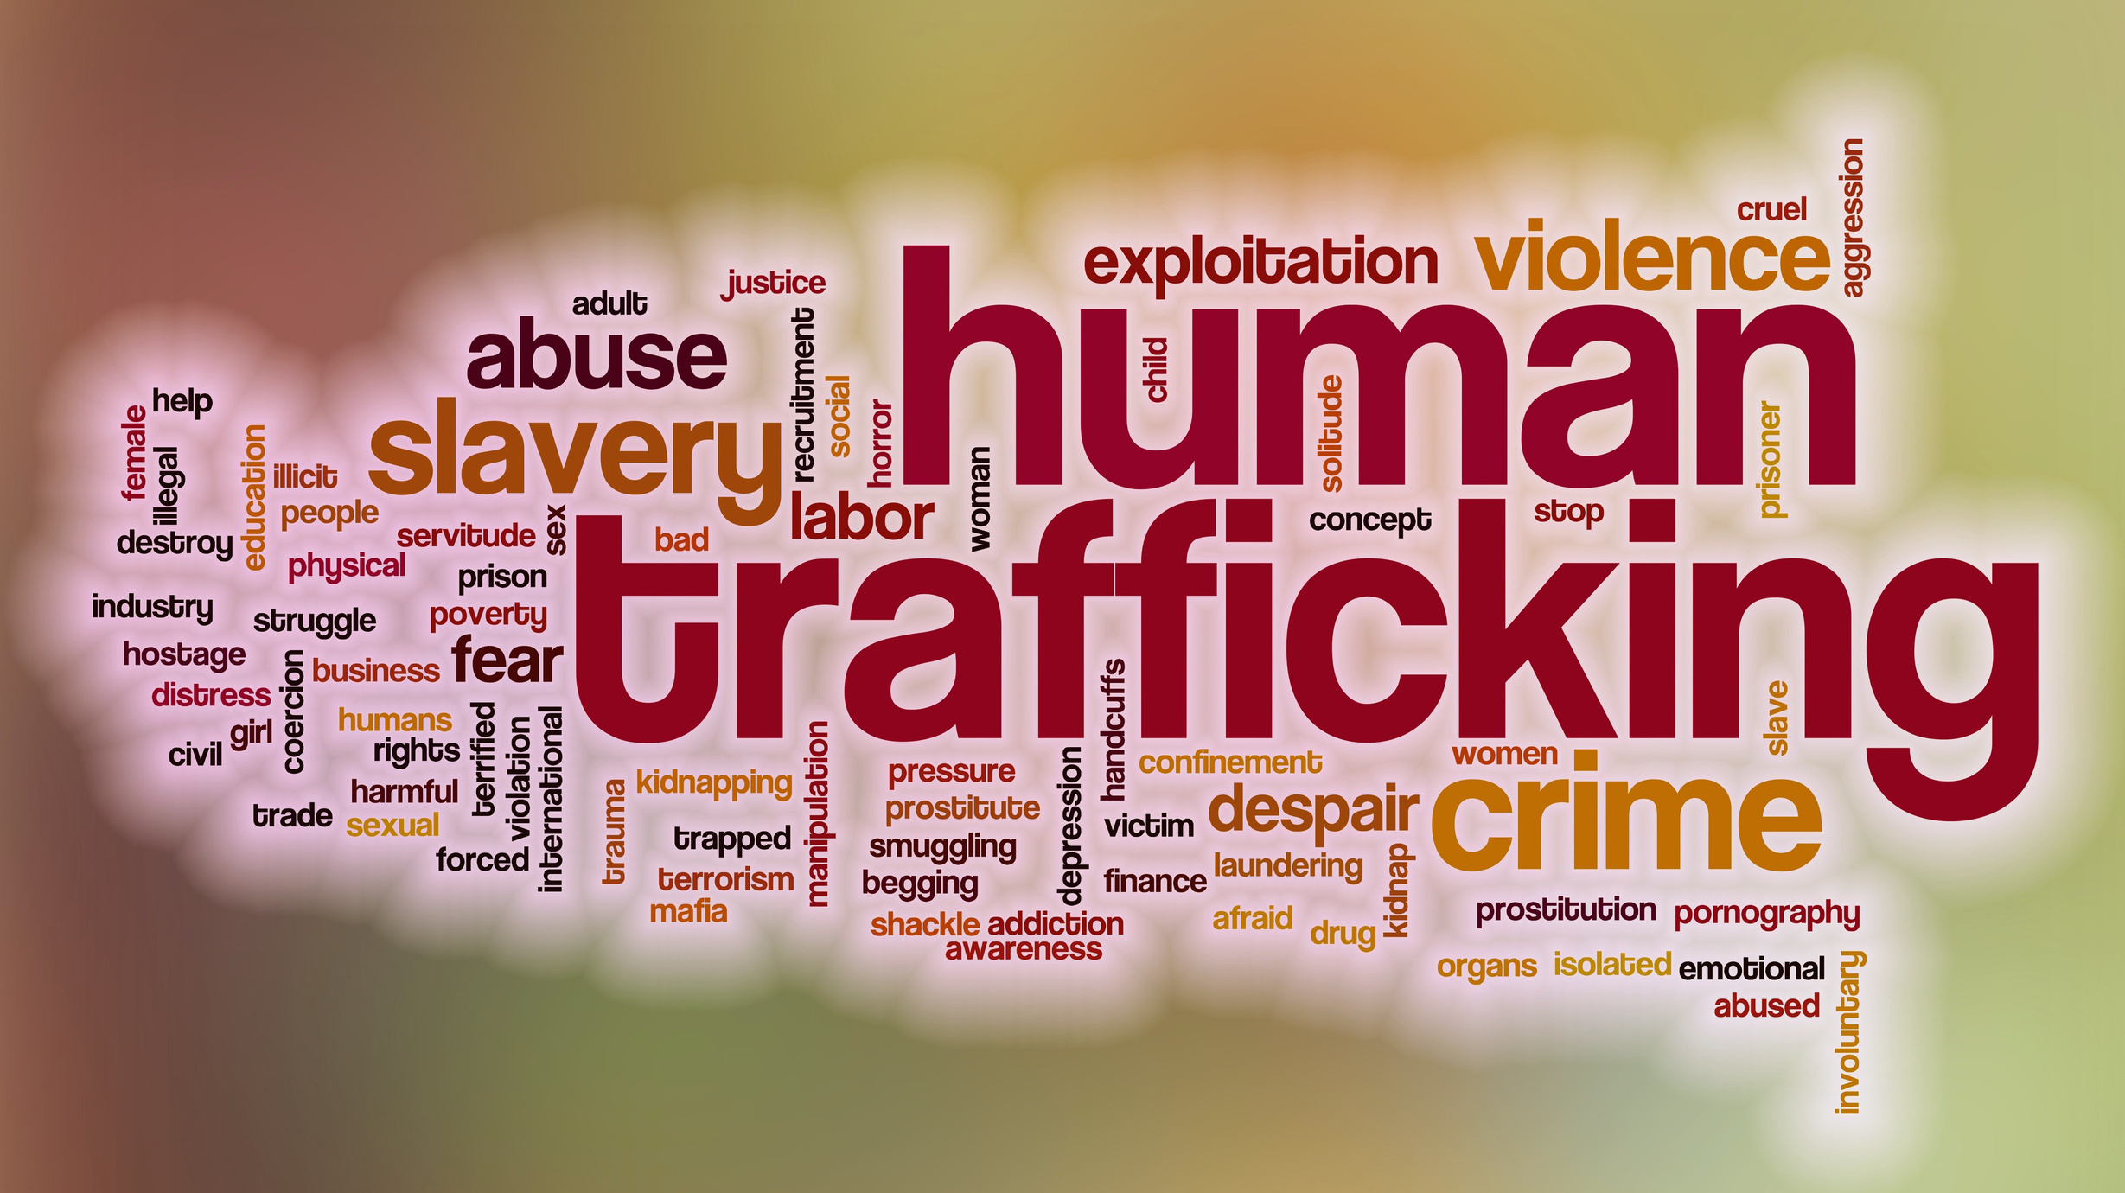

Slide 6
Social and Systemic
Risk Factors
Individual Risk Factors
Social and Systemic
Risk Factors
Low self-esteem
Lack of confidence
Need for approval
Need for love
Family dynamic
Lack of social support
Problems at school
Bullying
History of abuse
Gender Identity
Sexual Orientation
Racial Identification
Gender Inequity
Social Marginalization
Poverty
Toxic Masculinity
Normalized Exploitation
Community Isolation
Systemic Racism
Language barriers
Legacy of colonization
Highest
risk
xt

Slide 7
THE LEGAL DIFFERENCES
Human Trafficking
Obtaining Sexual Services
Sexual Exploitation
Criminal Code Section 279
Criminal Code Section 286
Criminal Code Section 153
Recruitment
Transports or transfer
Exercise of control
Force or coercion
Sexual or labour exploitation
Purchasing sexual services from anyone
3rd party receives material benefit from sexual services
Age of victim
Age of perpetrator
Relationship between them
Invites or counsels sexual acts

Slide 8
THE SPECTRUM OF CHOICE
NO CHOICE
COERCED
CHOICE
PERCEIVED
CHOICE
SITUATIONAL
CHOICE
APPARENT
CHOICE
CLEAR
CHOICE
No Consent
Coerced Consent
Manipulated Consent
Consensual (19+)
Consensual (19+)
Consensual (19+)
Kidnapped
Threatened
Dependency
Dependency
Economic Insecurity
Autonomous
Confined
Deceived
Romantic
Lack of opportunity
Access to opportunities
Independent
3rd Party Controlled
3rd Party Controlled
3rd Party Controlled
Independent
Independent
Limited
Access
(privilege)
Survival Sex
Work
Trafficking
Trafficking
Trafficking
Privilege
Coercion
Exploitation
Exploitation
Exploitative
Sex Work
Sex Work

Slide 9
Hotels and Human Trafficking
81%
''We would stay in places where we thought clients were comfortable coming as well... Of course we wouldn't pay extreme prices. But just nice enough and affordable so my profits were still ok."
of pimps use escort services business model
''And I think the customer feels better about [going to a nicer hotel]. They feel better about giving this girl their money, when really they are with pimps."

Slide 10
"I was a child spending a lot of time around a specific hotel for literal years. And nobody ever asked me questions, or called the police.”
94%
“...[My trafficker] was sitting outside in the [hotel] parking
lot waiting. He knew I was going to leave, so he was just
watching me… He broke the TV, threw it over the railing,
took the phone, smashed my face, put ashtrays in the
pillowcase and was swinging it [at me]. I was screaming,
but nobody did [anything]. It was all just girls that had
pimps themselves [around the immediate area], so
nobody’s going to say anything. I remember he took my
car, he took my phone and all that. So I was just sitting in
the parking lot and crying [and] bleeding. The [front desk
clerk] was just like “I’m not getting involved in all that”
and just said, “you guys can’t get a room here anymore,
I’m keeping your deposit.” [The front desk clerk]
wouldn’t even let me use the phone to call police.”
of Polaris survey respondents reported that they had never received any assistance, concern, or identification from hotel staff

Slide 11
"....So [my trafficker] knew which hotel I was going to be at.
The guy at the front recognized me. So when I checked
in, I was like “can you please not tell anybody that I’m
here?” [The front desk clerk] was really helpful. I didn’t
have to tell him I was running away. He didn’t call the
police which he knew I didn’t want, or anything like that.
That was helpful in itself, for him to just respect what I
was asking and putting me in a room that was not my
normal room. Things like that where he’s not necessarily
doing too much, but he’s recognizing [how to help].”

Slide 12
General Indicators
Important Cautions
Some of the indicators for identifying possible human trafficking may also suggest that sex work is taking place. If an employee identifies those signs then they should also look for:
• Victim appears to be under some form of control
• Is not fully consenting to the situation
• Is under the age of 18
• Verbal or physical abuse
• Restricted or controlled communications
• No freedom of movement
• No control of money, cell phone, or ID
• Exhibits fearful, anxious, or submissive behavior
• Dresses inappropriate- young girls may be dressed to look older
• No knowledge of current or past whereabouts
• Signs of poor hygiene, malnourishment, or fatigue
• Do not rely on physical appearance alone to identify victims - traffickers and victims can be different genders or ages, or wear different styles of clothing
• An individual's race or ethnicity, or how it differs from their acquaintance's are not indicators of human trafficking

Slide 13
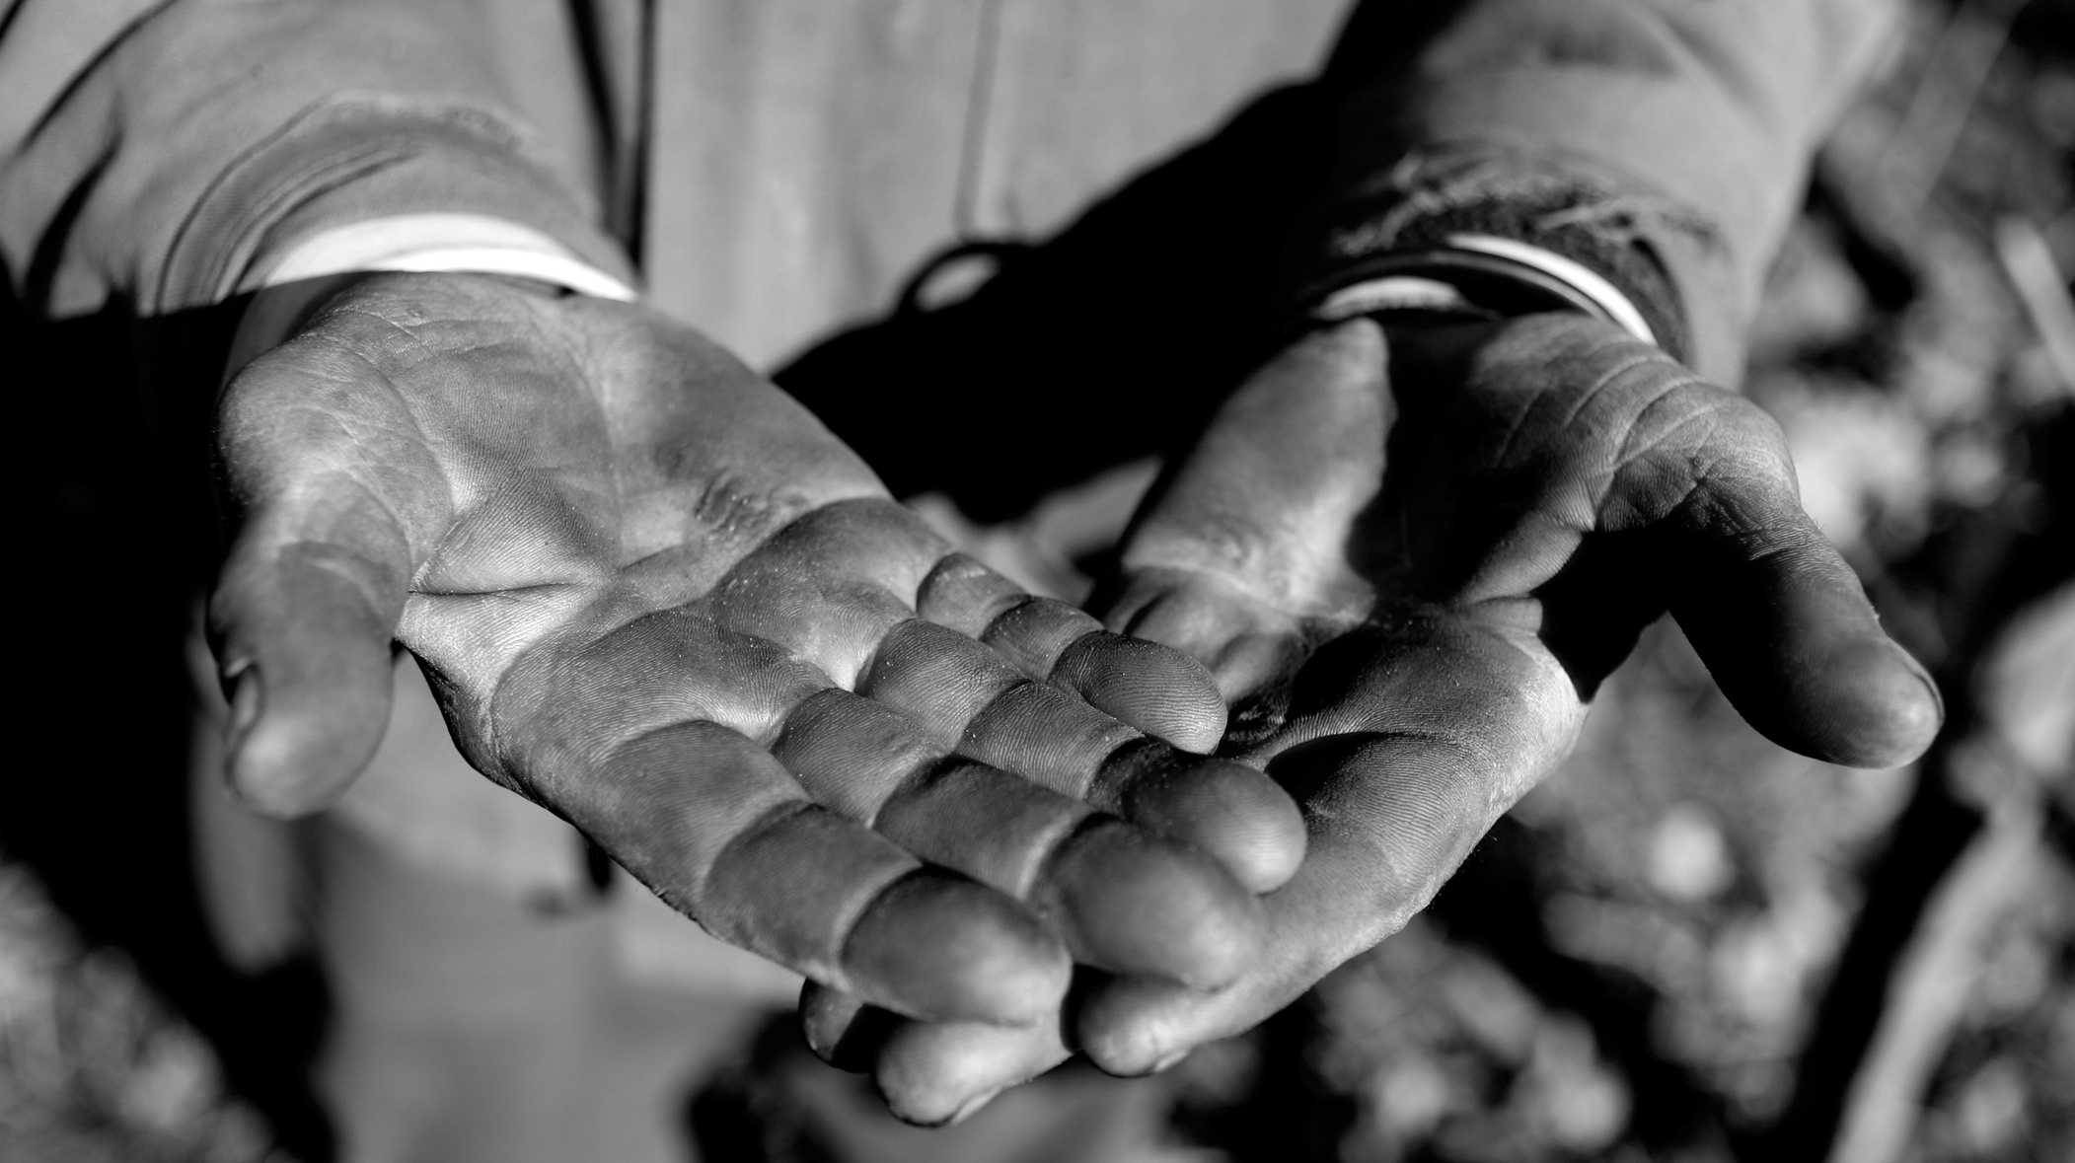
Hotels and Labour Trafficking
"Last night, I went to bed a slave. Today I wake up a free man."

Slide 14
The Benefits of Responsible Practices
“I remember when I was working in the Bay Area and on the hotel TV screen,
it kept saying “if you see something, say something” about [reporting a] bomb or something suspicious... So [there should be] something like that [with the trafficking hotline number] in the actual hotel room. Or maybe also
on the bathroom wall, or somewhere inside of a drawer for when they open
it up. If I would have seen something like that all the times that I just got beat up... I mean, I’ve had some
really bad experiences in hotel rooms, and if I had seen something like that I
would have called it.”

Slide 15
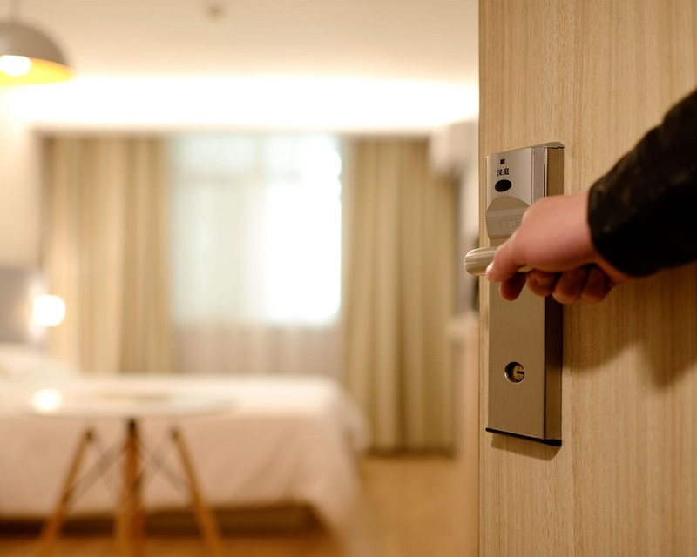
How can hotels help...
1. Formally adopt a company-wide Anti-Trafficking Policy
2. Train staff on what to look for and how to respond
Contact EFryNB for follow-up training at your facility

Slide 16
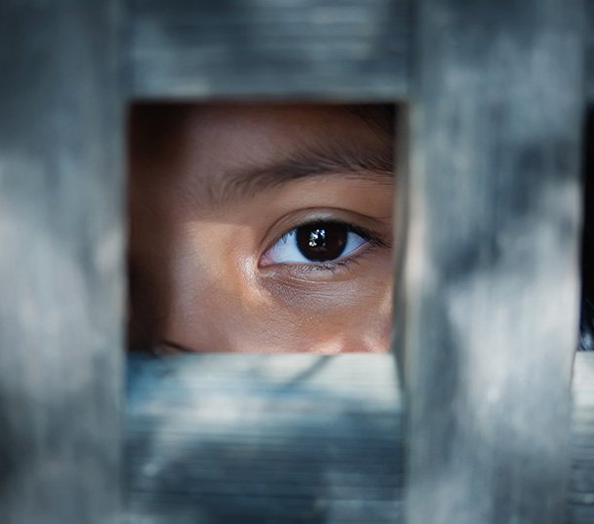
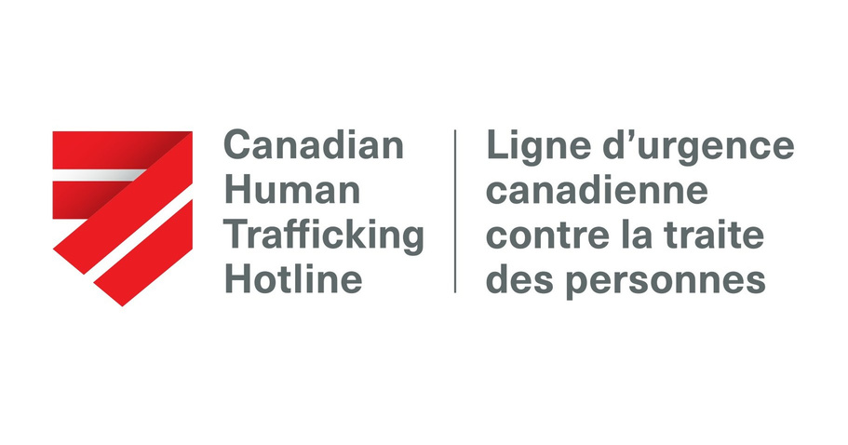
3. Hotel Points Donations and Local Shelter Support
4. Establish a response plan involving a safe reporting mechanism
5. Post the Canadian Human Trafficking Hotline
1-833-900-1010. 24/7 with more than 200 languages.

Slide 17
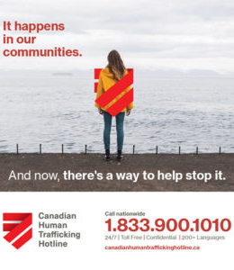
Calling the Hotline
• Automatic recording, French or English
• Is it an emergency
• All other requests

Slide 18
Truckers Against Trafficking
Offers training opportunities for those in the transportation industry - such as busses, trucking, highway enforcement, weigh stations, ect.
Check out their website for more information and resources!

Slide 19
Contact Me
Aubrey Heber
Community Outreach Support Worker
Its My Life Project
EFryNB
506-635-8851 (office)
aubrey.heber@efrynb.ca

Slide 20
Questions?

Slide 21
References
Howorun, C. (2021, October 21). Human Trafficking in your backyard. Retrieved October 22, 2021, from https://toronto.citynews.ca/2021/10/17/fighting-traffick-human-trafficking-in-your-backyard/
Emcsheffreyglobal, A. (2021, July 22). Forced to return to court and Testify, N.S. human trafficking survivor feels angry, 'helpless' - halifax. Retrieved October 22, 2021, from https://globalnews.ca/news/8050488/nova-scotia-human-trafficking-survivor/
Luz, V. (2020, October 08). The Canadian Centre to End Human trafficking. Retrieved October 22, 2021, from https://www.canadiancentretoendhumantrafficking.ca/human-trafficking-the-hospitality-industry/

Slide 22
References
T. (2019, May 23). 'last night, I went to bed a slave': Charges laid in human trafficking probe in Barrie | CBC News. Retrieved October 22, 2021, from https://www.cbc.ca/news/canada/toronto/modern-day-slaves-barrie-human-trafficking-1.5147251
Prevention, V. (2019, June 20). Human trafficking training about this course. Retrieved October 22, 2021, from https://www2.gov.bc.ca/gov/content/justice/criminal-justice/victims-of-crime/human-trafficking/human-trafficking-training/course-overview/about-this-course
Anthony, Britany (2018) On-Ramps, Intersections, and Exit Routes: A Roadmap for Systems and Industries to Prevent and Disrupt Human Trafficking: Hotels & Motels . Polaris, pg 20-39, https://polarisproject.org/wp-content/uploads/2018/08/A-Roadmap-for-Systems-and-Industries-to-Prevent-and-Disrupt-Human-Trafficking-Hotels-and-Motels.pdf

