Slide 1
Introduction to Outreach Officer Services for Employers
November 2021

Slide 2
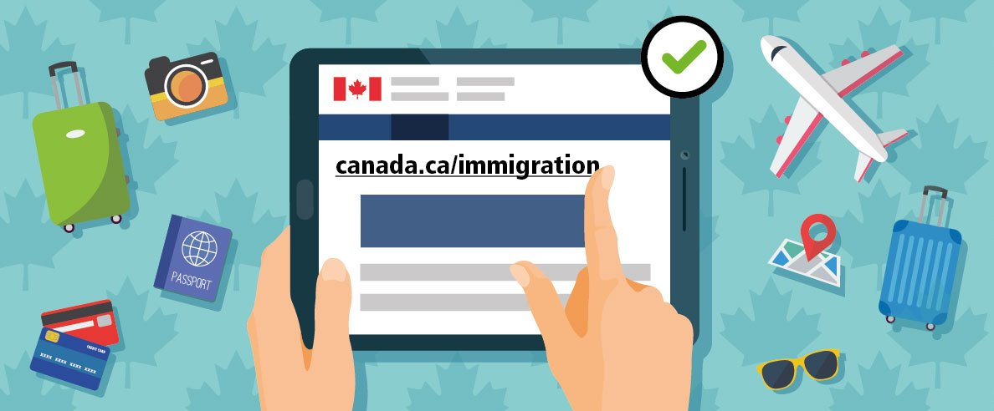
Immigration, Refugees and Citizenship Canada (IRCC) is the federal department that:
issues visitor visas, study permits and work permits;
grants permanent residence;
provides protection to refugees,
grants Canadian citizenship and issues passports; and
helps newcomers settle in Canada.

Slide 3
Canada’s Economic Immigration Programs
Temporary Work Permits to fill urgent, immediate or temporary labour shortages.
Permanent Resident programs enable immigrants to settle permanently in Canada.

Slide 4
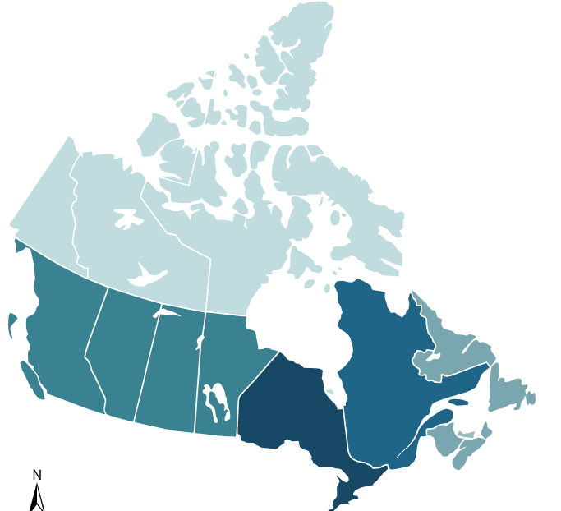
IRCC’s Outreach Officer Network
Outreach Officers across Canada:
promote economic immigration programs and initiatives; and
help employers learn how the immigration system can support their hiring needs.
Hariana Brooks and Michael Frenette are the Outreach Officers in the Atlantic
IRCC.DNEngagement@cic.gc.ca
4

Slide 5
Outreach Officer Services for Employers
Educational and promotional activities
Help understanding immigration options
Connect to the appropriate resources
Receive feedback on issues, gaps and local labour market
Support with completing applications
Process and/or expedite applications
Influence the outcome of an application
Address case-specific enquiries

Slide 6
Virtual Café
Chat live with us
Virtual Learning Series
Attend another information session
Individual Support
Learn about your immigration options
Educational Activities
Offered twice a month
New topic each month
Have us give a presentation or speak at an event
Opportunities for Employers in the Atlantic

Slide 7
Need More Information?
IRCC.DNEngagement@cic.gc.ca
canada.ca/hire-immigrants
Infosheets - Canada's economic immigration programs

Slide 8
Thank You! Merci!
Hariana Brooks
IRCC Outreach Officer
Halifax, NS
Michael Frenette
IRCC Outreach Officer
Moncton, NB

